Slide 1
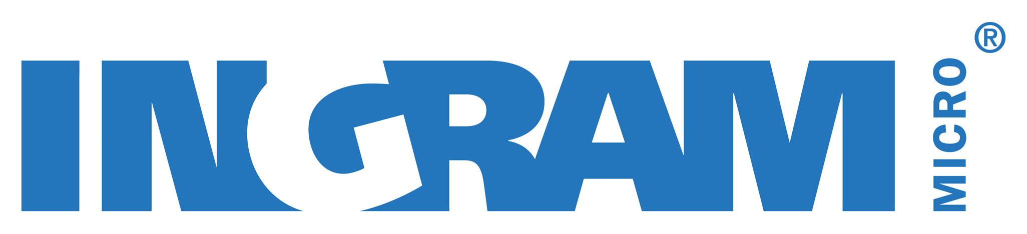
Windows 10 Pro for Your Modern Workforce
Presented by Tommy Luong

Slide 2
Agenda
Windows 10 Pro means Business
Monetizing Windows as a Service
From Windows Pro to Windows Enterprise
A few vertical scenarios

Slide 3
Windows 10 Pro means business
The most comprehensive security for your business
Best-in-class management that grows with
your business
Get more done
with the most productive tools.
Notes:
We get it, the small businesses landscape is intensely competitive. You need devices and platforms that provide every possible edge. A business PC with Windows 10 Pro offers just that – the most comprehensive security, more control over your technology, and the freedom to let your and your employees work in the most productive and personalized way possible.
The most secure Windows devices for your business
Windows 10 Pro devices are the most secure Windows devices ever built, delivering a multi-layered approach to protecting your business information, your customer data, your employees’ online identities and, ultimately, your reputation.
Simple management that grows with your business
Windows 10 Pro makes it easier than ever to manage an often complex IT environment, including your devices, user identities, apps and policies. So you can confidently focus on doing what you best – running your business.
Get more done with the most productive tools
Windows 10 Pro gives a boost to your productivity: it helps you work faster, focus quickly on the task at hand, and access what you need, when you need it, from wherever you are. And all the while allowing you to work in a way that works best for you.

Slide 4
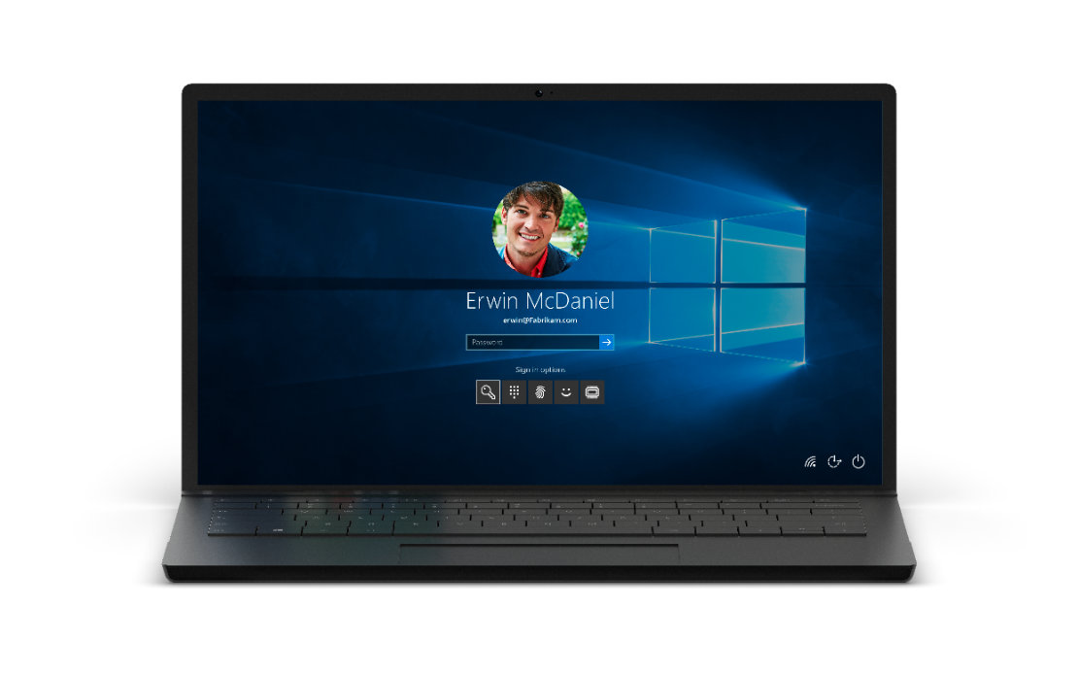
The most comprehensive security
Help protect your business information, customer data, employee identities and, ultimately, your reputation
Free, built-in protection from security threats
Windows Defender
Windows Firewall
Trusted Boot
A lost device doesn’t have to mean leaked data
BitLocker
BitLocker to Go
Employees won’t need to remember passwords
Windows Hello*
Securely separate business from personal information
Windows Information Protection
*Windows Hello requires specialized biometric hardware.
Notes:
Windows 10 is the most secure Windows that Microsoft has ever built, offering a multi-layered approach to protecting your company from modern day security threats. Windows 10 Pro security features provide peace of mind by encrypting data, preventing accidental information leaks by employees, and helping keep everything on lockdown if a device is lost or stolen. All together Windows 10 makes for a thoroughly comprehensive approach to helping protect your business information, customer data, employee identities and, ultimately, your reputation.
Free built-in protection from current and future security threats
Windows Defender: Windows 10 offers built-in malware protection to help keep you safe from viruses, spyware, and other malicious software. Windows Defender runs in the background, notifying you when you need to take specific action.
Windows Firewall : Built into Windows 10, Windows Firewall helps notify you about suspicious activity if a virus or worm tries connecting to your PC. It can also block viruses, worms, and hackers from trying to download potentially harmful apps.
Trusted Boot: Windows 10 closes off the pathways that allow malware to hide by starting before the malware does, helping to ensure your PC boots use only trusted software. Rest assured that your system will start with integrity and help defend against modern threats.
A lost device doesn’t have to mean leaked data
BitLocker + BitLocker To Go: Keep your peace of mind by encrypting your data on your computers’ hard drives and even on your USB drives, so your business information is protected when a device is lost or stolen.
Employees won’t need to remember passwords
Windows Hello: You are the password. Windows Hello is the password-free sign-in that gives you the fastest, most secure way to unlock your Windows devices. Using your face or fingerprint, it recognizes you apart from all others, waving you in with a friendly hello. And it even works on apps and Microsoft Edge websites.
Securely separate business from personal information
Windows Information Protection: You can control how your employees use your business data – blocking them from copying customer or financial data into social media apps, for example. So you can help protect data wherever it lives — without affecting your user experience.

Slide 5
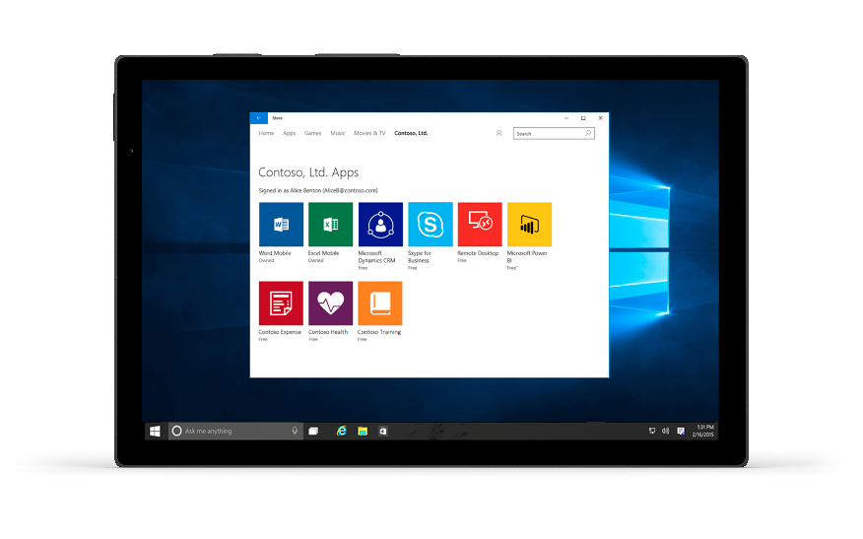
Best-in-class management
Manage your complex IT environment, including your devices, user identities, apps and policies with ease.
Single sign-on and more
control over your devices
Azure AD join *
MDM Client
Domain join
Group Policy
Decide when and
how to update
Deferred Updates
Windows Update for Business
Manage your business apps with flexibility and ease
Windows Store for Business**
Assigned Access
Client Hyper-V
*Azure AD sold separately. **Available in select markets. Functionality and apps may vary by market and device.
Notes:
Dealing with the day-to-day management of technology can distract from what you and your team do best: running your business.​
Windows 10 Pro helps eliminate that hassle with a set of tools designed to reduce the time and energy spent managing IT. Pro devices are designed to work seamlessly with your servers, Office 365, and cloud services, making it all work together for your business. ​
​
Single sign-on and more control over your devices
Azure Active Directory Join- Employees can use a single login across Windows 10, Office 365, and other Microsoft services, making logons and passwords easier to manage. The shared logon works on PCs, tablets, and phones.
Mobile Device Management (MDM) client- Windows 10 Mobile Device Management (MDM) support, lets you use cloud-based management services to control business and personal devices. Your employees get access to corporate applications, data, and resources from virtually anywhere on almost any device, while IT gets help keeping your business information secure.
Domain Join + Group Policy- IT staff can easily manage PCs, user accounts and groups, security policies, and get easy access to files and printers when you pair Windows 10 Pro with Windows Server. You can even define specific security and networking policies for your users and devices.
Decide when and how to update
Deferred Updates - With deferred updates, you get new Windows features and functionality, after they’ve been vetted and approved by other users, while still continuing to receive security updates and critical fixes straight away.
Windows Update for Business- Your IT staff can get more done, since Windows 10 Pro gives them control over system and app updates. You’ll get access to the latest innovations from Microsoft, while being able to reduce management costs, maintain more control over the update process and make better use of everyone’s time.
Manage your business apps with flexibility and ease
Windows Store for Business- Designed for organizations, Windows Store for Business gives you a flexible way to find, acquire, manage, and distribute free and paid apps to Windows 10 devices.
Assigned Access- Windows 10 Pro lets you set up a device for a single use or “kiosk.” Users can only interact with one Windows Store app and cannot change system settings.
Client Hyper-V- Run multiple operating systems at the same time on one computer, letting you create and manage virtual machines and their resources.

Slide 6
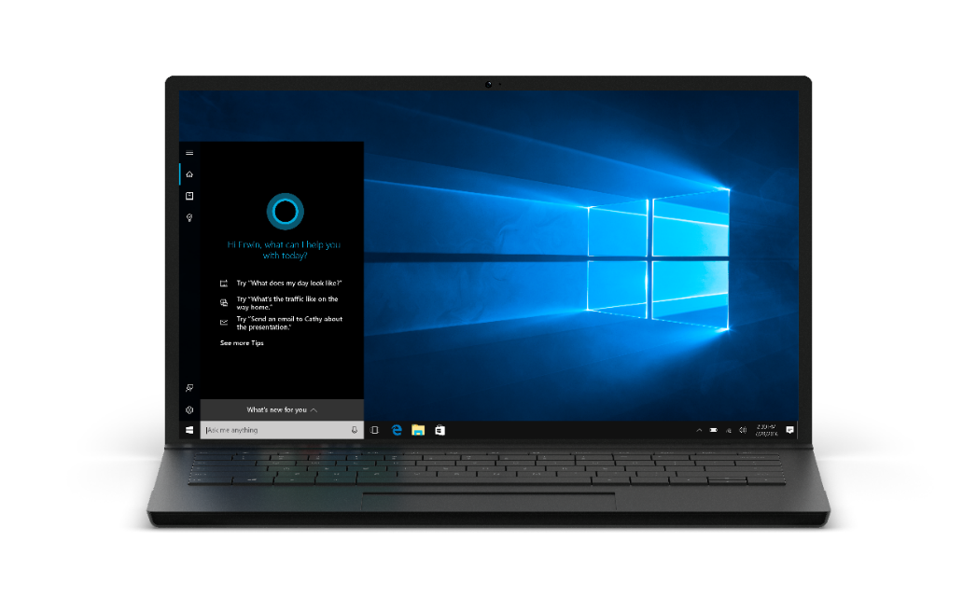
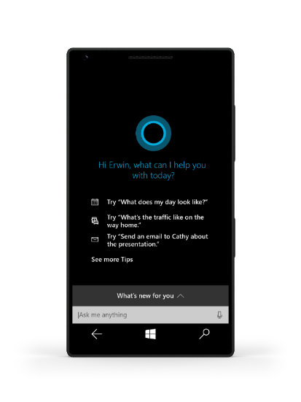
Get more done with the most productive tools
Work faster, and access what you need, when you need it from wherever you are.
Access whatever you need, wherever you are
Remote Desktop*
OneDrive for Business
Stay focused and finish first with new productivity tools
Start Menu
Live Tiles
Virtual Desktop
Snap Assist
Tablet Mode
Turn thoughts
into action.
Voice/Pen/Touch/Gesture**
Windows Ink**
Microsoft Edge
Your digital assistant to handle crucial tasks
Cortana*** at work
*Remote Desktop requires internet connection; **Device dependent; Windows Ink requires touch capable tablet or PC. Pen accessory may be sold separately.
***Cortana available in select markets; experience may vary by region and device
Notes:
Windows 10 Pro allows you and your team members to stay focused, stay connected and, most importantly, stay productive. You can access what you need, when you need it, from wherever you are. You can take advantage of new applications and unique ways to get things done. And you can even have your very own digital assistant. All of which is, well, good for business.
Access whatever you need, wherever you are
Remote Desktop: Work anytime, anywhere. Access your own desktop - with all your files, folders, and apps just the way you left it - from virtually anywhere and on any device. All you need is Windows 10 Pro and an internet connection.
OneDrive for Business: Collaborate more easily. You can search, access, share and save your OneDrive for Business files easily from your device. You and your team can work offline and your files automatically sync once you’re back online, so everyone always has access to the latest version across their favorite devices.
Stay focused and finish first with new productivity tools
Start Menu + Live Tiles- Get to work quickly and stay productive with familiar features in Windows 10. The Start menu lets you pin your go-to apps and files for fast access. Live Tiles beam updated info – like your email, appointments, and headlines – so you don’t need to open the app.
Virtual Desktop + Snap Assist- Keep command of your screen. Snap Assist makes it easy to snap apps into place to optimize available screen space. If your screen is getting crowded, you can create virtual desktops with just the items you want – great for when you don’t have multiple monitors to work with.
Tablet Mode- Use your laptop like a tablet. You can get a smooth, touch-first experience on your 2-in-1 or touchscreen laptop. Onscreen features adapt for easy navigation and apps scale smoothly from the smallest to the largest displays. You can easily run in or out of Tablet Mode anytime you want – your screen will give you a smooth transition and a beautiful display.
Turn thoughts into action faster
Voice/Pen/Touch/Gesture- Windows gives you more interaction options to choose from so you can use what feels right and works best. Beyond just traditional keyboard and mouse inputs, you can use your device in the way that’s most natural for you and the best fit for what you’re doing. You can even switch from one interaction type to another for maximum comfort and productivity.
Windows Ink- Quickly turn thoughts into action with the magic of Windows Ink. Naturally capture notes at the speed of thought with no need to be logged in. And powerfully pair inking with Office to effortlessly make edits, create content and drive ideas forward. Windows Ink makes using your pen easy and obvious on Windows. With the all new Windows Ink Workspace, all ink-powered apps and quick actions are right at your pen’s tip.
Microsoft Edge- Microsoft Edge is a safe, fast browser, always up-to-date* and designed to work with today’s websites and services. With a web experience that’s personal, responsive, and all about getting things done online, you can add extensions, write** or type directly on webpages. You can even share your mark-ups with colleagues, save articles in your reading list to view later, and read in a view that lets you clear away distractions from online articles
Your digital assistant to handle crucial tasks
Cortana at Work: Cortana is a digital assistant designed to help you get things done. Ready on day one to provide answers and complete basic tasks, Cortana learns over time to become more useful every day. Count on Cortana to help do and find things, be best at reminders, and work across more of your devices.

Slide 7
Monetizing WaaS

Slide 8



Windows 10 is your foundation for services revenue
PARTNER MANAGED RECURRING
REVENUE IS PRIMARY GROWTH DRIVER
IP AND NEW INDUSTRY/ FUNCTION SCENARIOS
PROJECTS
Windows 10 momentum/
customer
interest
Device
refresh
OFFICE 365, EMS, & AZURE AD: IMPLEMENTATION AND RECURRING REVENUE
30–40% project margin
40–60% IP margin
MANAGED SERVICE (DESKTOP+) MONTHLY RECURRING REVENUE
30–40% margin
NEW WINDOWS PROJECTS: SECURITY AND LIFECYCLE MANAGEMENT
DEVICES & ACCESSORIES
HW/SW RESALE
40–50% margin
Windows 10 momentum/
customer
interest
POC, PILOT, SCCM PREP & DEPLOYMENT PROJECTS
30–40% margin
“Windows 10 unlocks cloud profitability. Without Windows 10 we won’t have
a successful cloud business.”
Chris Hertz, Founder
5–15% margin
20–30% margin bundled as monthly managed service
20–30% margin
PARTNER REVENUE BUILT ON WINDOWS 10 FOUNDATION

Slide 9


Total Economic Impact of Microsoft Windows 10 http://windowsready
The
Total Economic
Impact of Windows 10
Deployment is easier
Before
After Windows 10
Deployment Time
4 years
2 years
Deployment IT Resources
15 FTE
5 FTE
Installation IT Time
60 Min
5 Min
Financial benefits
Security benefits
$403 per user
3 year
N P V
188%
Security issue remediation savings
“[New features] help Windows 10 to be probably the most secure out-of-the-box Windows Platform”
IT Manager, US
Professional Auto
Racing Team
ROI
13 Months Payback
33%
Reduction in Security issues & Time to resolve
$710k
Per year
Destop Mgmt.
Time Savings
“Windows 10 enables productivity and increased business performance”
15%
Source: “The Total Economic Impact™ of Windows 10, a commissioned study conducted by Forrester Consulting on behalf of Microsoft, June 2016. Results are for a risk adjusted composite organization based on customer interviews
Notes:
UPDATE TO IT TIME: From TEI study pages (13 and 14). Link to Study
The organization also estimates that IT effort required for OS deployment has reduced from nearly an hour to just 5 minutes on average per client device, due to increased self-service installation, unattended installation, and integration with System Center Configuration Manager, enabling the IT team to automate deployment by “waking” client devices overnight and initiating installation. “For the Windows 7 program over the course of years, we would have had hundreds of people at any one time engaged against it,” said the GM of IT services for the public health department, “[With Windows 10], the upgrade has been very seamless, and we achieved this with the core team of five people.”

Slide 10
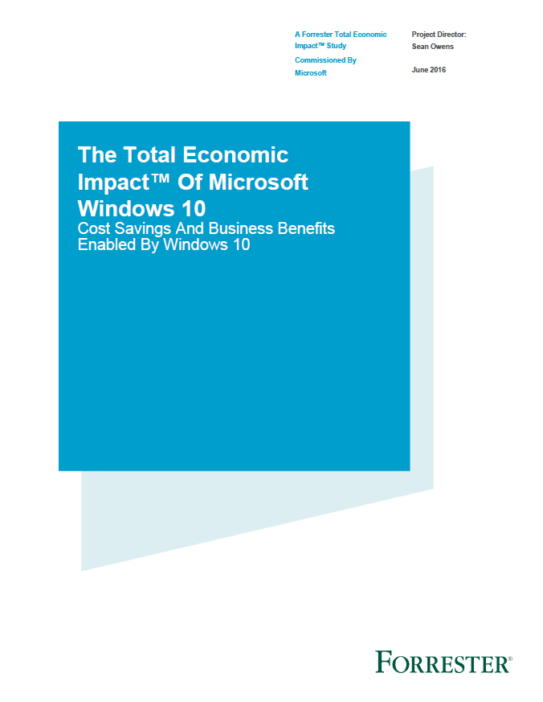
Windows 10 deployment pays for itself in 13 months
Forrester Consulting Total Economic Impact findings:
Improved productivity, mobile workers gain
25% of time previously unavailable for work
15% savings in
IT Desktop Management
33% reduction in security
issues and time to resolve
$710K in security issue
remediation savings
$403 per user 3 year NPV
188% ROI
13 month payback
Source: “The Total Economic Impact^{(TM)} Of Windows 10, a commissioned study conducted by Forrester Consulting on behalf of Microsoft, June 2016.
Results are for a risk adjusted composite organization based on customer interviews.
Notes:
Customers want to know the financials of Windows 10, and Forrester has analyzed the Total Economic Impact, we will make this report available for you to use with your customers.
To start with, most customers already are licensed to run Windows 10, so if they don’t deploy, they are not using something very valuable that they have already paid for.
We’ve talked about how the deployment costs are much lower than with prior versions, so now lets focus on three of the key economic benefits highlighted in this report:
15 % savings in IT desktop Management – “Windows 10 requires less IT administration time to install, manage, and support, with easy-to-use features and more self-service functions.”
33% reduction in Security issues and time to resolve – “New features such as Credential Guard and Device Guard and improvements in existing features (such as BitLocker), security events requiring IT remediation are reduced or avoided.”
25% reduction in employee time previously unavailable for work especially mobile workers, “enabling them to get more done more quickly wherever they may be.“
Additional saving in Application Provisioning, Reduced or eliminated 3rd party licensing, faster wake and boot time
With these savings against a lower deployment cost in less than half the time, they calculated a positive NPV of $403 per user over 3 years, a dramatic 188% ROI, and payback in only 13 Months.
Your customers can’t afford NOT to deploy the Windows 10 system that they already own!
To help your customer understand how these savings would apply to their situation we have developed a TCO calculator for you to use with them for economic justification

Slide 11
From Windows Pro to Windows Enterprise
*upgrade to Enterprise, requires Pro license (ie: can’t go from Home to Enterprise)

Slide 12
Windows 10 Enterprise
Do great things. The best Windows ever keeps getting better
Safer and more secure
More productive
More personal
Powerful, modern devices
Windows Information Protection
Windows Hello
Credential Guard
Device Guard
AppLocker
Windows Defender Advanced Threat Protection
Azure Active Directory Join
Mobile Device Management
Application Virtualization
(App-V)
Windows Ink
Windows Store for Business
Cortana Management
Managed User Experience
User Experience Virtualization (UX-V)
Windows 10 for Industry Devices
Innovative designs
New experiences
Best in class performance
The most trusted platform
Always up to date
The most versatile devices

Slide 13
Additional protection, flexibility, and control
Pro
Enterprise E3
Enterprise E5
●
●
●
●
●
●
●
●
●
●
●
●
●
●
●
●
●
●
●
●
●
●
●
●
●
●
●
●
●
●
●
●
●
●
●
●
●
●
●
●
●
Enterprise-grade security
Windows Hello*
Windows Information Protection (to be delivered in the future)
BitLocker
Credential Guard
Device Guard
AppLocker Management
Managed User Experience
Deployment flexibility and enhanced controls
Dynamic Provisioning
Current Branch for Business
Mobile Device Management
Azure Active Directory Domain Join
Domain Join and Group Policy
Windows Store for Business
Windows Update
Windows Update for Business
Client Hyper-V
Remote Desktop
App-V and UE-V
Branch Cache
Direct Access
Telemetry
COIN
Simplified licensing
Subscription-based Access
Per-User Licensing
Central Partner Portal
Cloud-based Provisioning
Partner-managed IT
Windows Defender Advanced Threat Protection
●
●
●
●
●
●
●
●
●
●
●
●
●
●
●
●
●
●
●
●
●
●
●
●
●
●
●
Representative list, for a full placemat of Windows 10 features, please visit the Windows.com website * Windows Hello requires specialized biometric hardware
Notes:
Windows 10 Enterprise E3 offers all of the features of Windows 10 Pro, along with extra layers of security and management features for those businesses that need them, such as:
Greater security to protect sensitive data and ensure compliance using Credential Guard, Device Guard, AppLocker Management, and Managed User Experience
Enabling a consistent, personalized, desktop experience for employees with multiple devices – making it easier to stay productive from device to device – with UE-V
Making sure that all of your apps stay current and protected with the latest security updates and functionality using App-V.
BranchCache, which allows users in remote locations to cache files, websites, and other content from central servers, so content is not repeatedly downloaded across the network
Direct Access, which allows remote users to more securely and easily access your internal network resources by simply connecting to the Internet
Windows 10 Enterprise E3 can also help you simplify device management and free up your resources to focus on more strategic priorities with:
A subscription-based licensing model that helps you lower up front costs
Per-user licensing which eliminates device counting and make it easier to stay compliant
The ability to easily access all of your cloud services in one central partner portal
Cloud-based provisioning managed by your trusted partner, who handles all aspects of device deployment, subscription purchasing and support
Windows 10 Enterprise E5 includes all of the features of Enterprise E3, plus Windows Defender Advanced Threat Protection, which provides a new post-breach layer of protection to the Windows 10 security stack. Windows Defender ATP gives you the ability to detect, investigate and remediate Advanced Attacks and data breaches on your networks.

Slide 14


Identifying target customers
Customers already on Windows 10 Pro
Customers
with Complex
IT or security
requirements
Customers
with existing
CSP
subscriptions

Slide 15
Paths to Windows 10 Pro
Get from… | ..to Windows 10 Pro
 | Retail | Windows Store (ESD) | Volume Licensing: Open/OV/OVS
 | Full license | Upgrade license | Upgrade license | Full license
Windows XP/Vista Home | Windows 10 Pro FPP ($199) | N/A | N/A | GGWA-SMO ($159)
Windows XP/Vista Pro |  |  | Pro VL Upgrade ($159)
Windows 7/8.1 Home | Upgrade to Windows 10 Home included in all Windows CSP subscriptions at no extra cost. Upgrade links and instructions available to tenant admins in Office 365 Admin center. Windows 10 Home devices must be upgraded one final time to Windows 10 Pro via the Windows 10 Pro Pack available in the Windows Store for USD$99
Windows 7/8.1 Pro | No extra cost. Upgrade to Windows 10 Pro included in all Windows CSP subscriptions. Upgrade links and instructions available to tenant admins in Office 365 Admin Center.
Windows 10 Home | Windows 10 Pro FPP ($199) | Pro Pack ($99) | N/A | GGWA-SMO ($159)
 | All prices estimates only

Slide 16
Scenarios

Slide 17
Challenges facing Organizations
!
Enhanced mobility and collaboration
Data leaks and targeted attacks
Compliance regulations
Increased threat exposure
Greater risk
Evolving threats
Increased costs
Antiquated defenses
Eroding public trust
Increased scrutiny
Complex regulations
Legal implications
Notes:
Suggested slide time: 4-5 minutes
Key points to cover
Enhanced mobility and collaboration invites risk.
Data leakage incidents are costly.
High regulatory scrutiny make this a top priority for financial services organizations.
Speaker notes
We just talked about the digital transformation and evolution to a mobile, collaborative workforce and customer base that needs data access. It’s also true that customer data, including account numbers and personally identifiable information, represents a significant target.
Here are some other things Microsoft sees in your industry. You’re probably seeing them too.:
Targeted exploits like cybercrime and fraud: Financial services firms are a top target for cybercrime and fraud, as we just examined. Today, well-organized and well-funded “hacktivists,” terrorists, and nation states are committing increasingly frequent and complex cybercrimes. Occupational fraud, mostly through employee theft, is also a growing, global problem for financial services organizations such as the example we saw with Wells Fargo.
Increased threat exposure as financial institutions increase mobility and collaboration: Firms are letting people bring their own devices into the environment. Now, think back to that perimeter discussion—the model of the fort being secured is no longer enough; now you must think about your people too.
Risks of doing business anywhere: Financial services are embracing customer-centricity and new mobile technologies. Firms are seeking to empower personnel with secure access to the right information at the right time—so that teams can work securely from almost anywhere on any device.
Evolving threats: credential theft and advanced persistent threats. Familiar threats like malware are evolving. Modern attackers are increasingly focused on creating extraordinary damage. Meaning the risk is no longer just one person's credentials, but an infiltration to the organization at large. Even organizations with enormous security budgets and elite security analysts are struggling to address these modern threats.
Legacy devices and antiquated defenses: Passwords have become a problem, not a solution. Legacy devices may not be equipped with the necessary hardware-based security for modern threats or may not be supported with the necessary software updates to protect against today’s malware.
Increased compliance complexity. As we discussed, financial services firms are under extremely high regulatory scrutiny, making compliance and risk management top priorities.
Growing costs of lost and leaked data: Financial services firms need to protect their franchises by ensuring that their information and workplace environment is secured. Protecting corporate and customer data is a top priority, especially as firms re-evaluate and transform their business strategies to embrace the four megatrends of mobility, social, cloud, and big data. And data leakage is real. 87% of senior managers admit to regularly uploading work files to a personal email or cloud account. As well, 58% have accidentally sent sensitive information to the wrong person. ¹<Note to presenter: this is a general statistic for the US, not financial services specific>
Eroding customer trust: Customers and regulators are less trusting of financial institutions than they were before the 2009 financial crisis. As a result, there is increased pressure for transparency and for the ability to demonstrate strong risk management and business integrity. According to Forbes: “Just 45% of people are confident that their data held by businesses is secure…Even among the 45% who believe their data is safe, just one data breach could be enough to erode that confidence and cause them to start looking for alternatives.” ² Note to presenter: these are general, global statistics across industries>
It’s a lot to juggle. Let’s look more into the unique challenges your team roles are facing—individually and together—in their day-to-day responsibilities.
[Advance slide]
Sources:
¹ https://www.shrm.org/ResourcesAndTools/hr-topics/technology/Pages/Data-Breach-Worst-Offenders-Executives.aspx
² http://www.forbes.com/sites/elenakvochko/2016/04/04/trust-as-product-strategy/#35a8c7e058d2

Slide 18
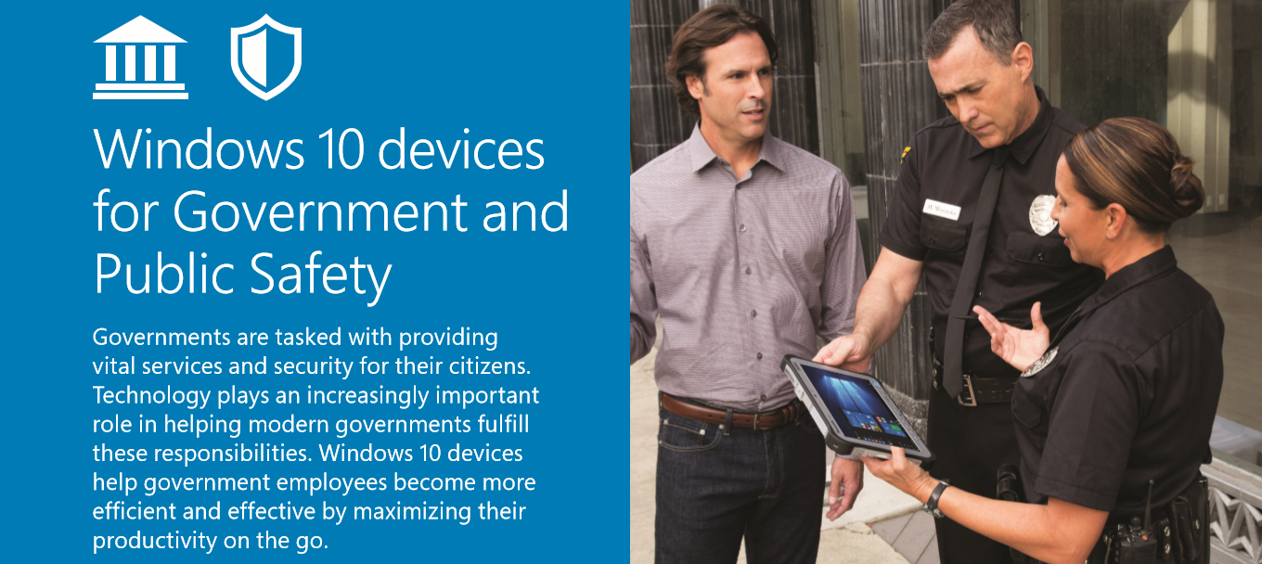
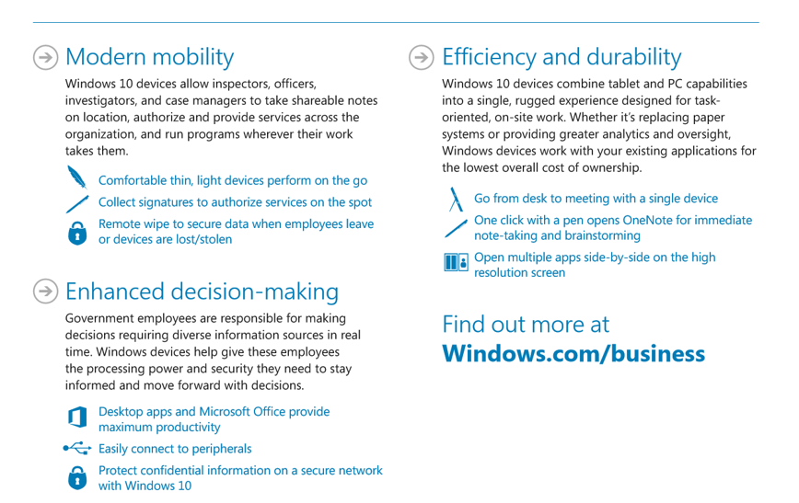

Slide 19
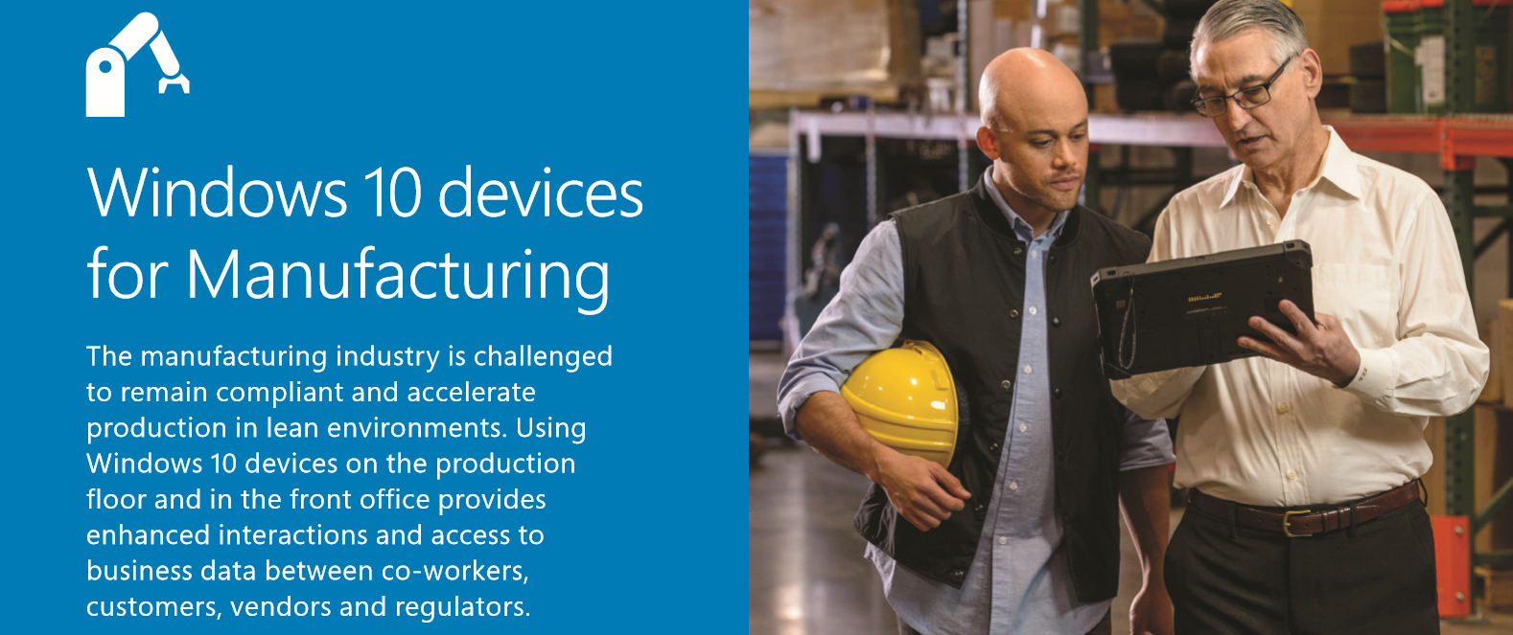
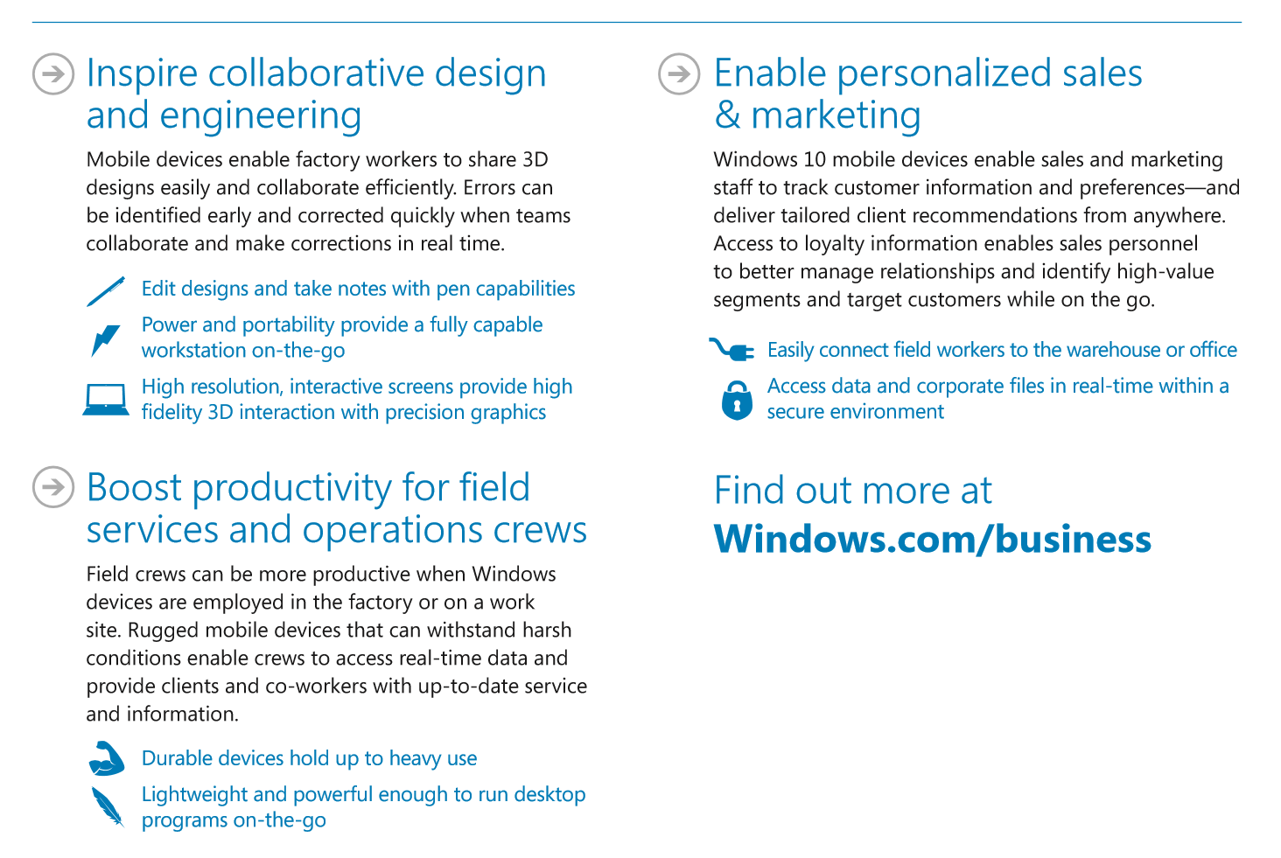

Slide 20
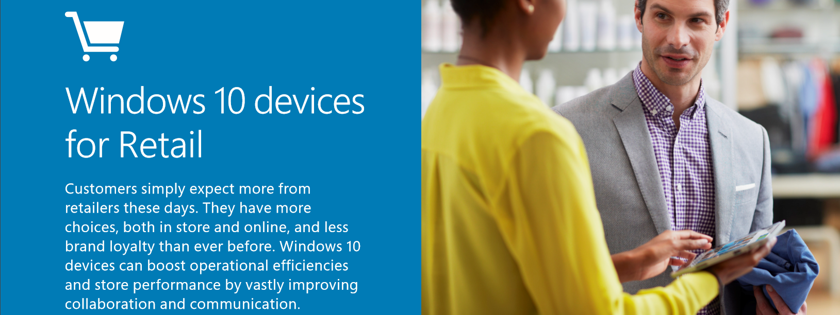
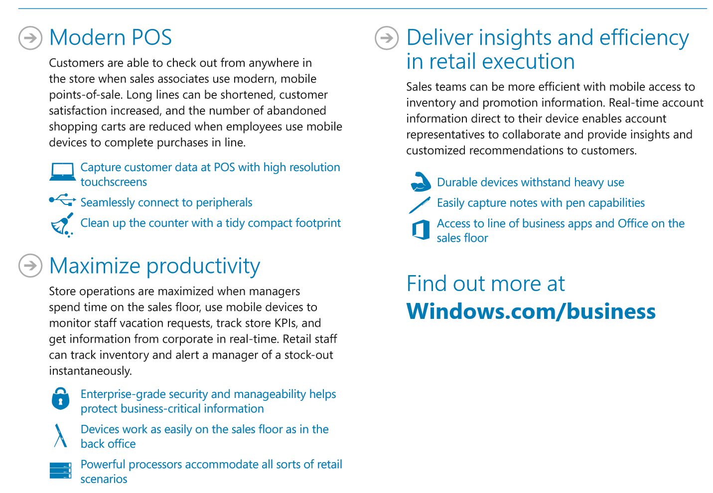

Slide 21

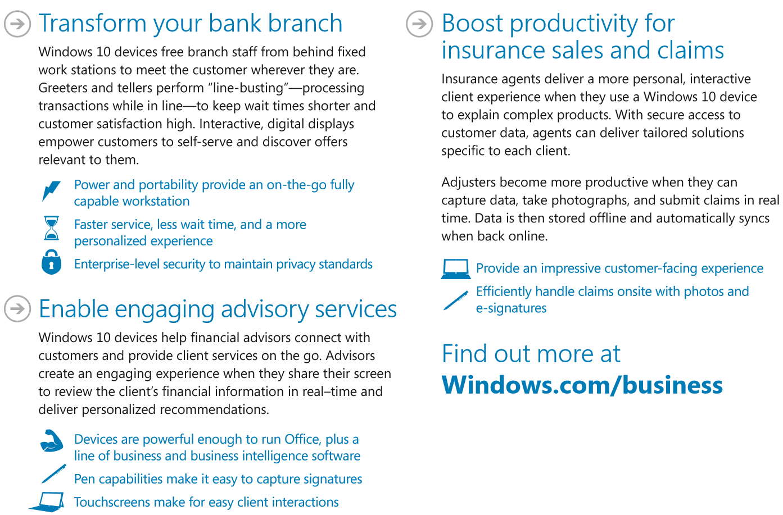

Slide 22
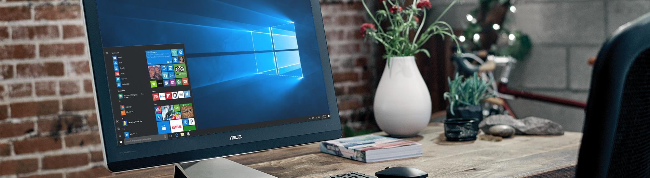

Windows 10 Pro means business
Most comprehensive security
Best-in-class management
Most productive tools
Most comprehensive security
Windows Information Protection
Active Directory Join & Group Policy
Windows Update for Business
Cortana at work
Faster to done
BitLocker & BitLocker to Go
Windows Hello
Windows Store for Business
Mobile Device Management
Windows Ink
Remote Desktop
Some features require disclaimers for use in external marketing. Some apps sold separately, availability and experience may vary. Features vary by market and device.

Slide 23
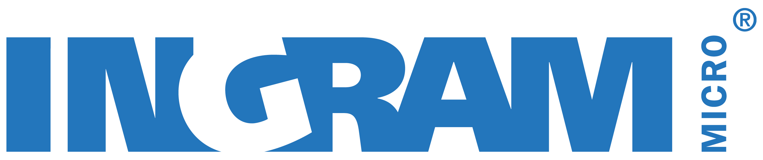
Ingram Micro Recommends Microsoft Software

