Slide 1


Why SMB customers need new devices
Windows 10 Pro device opportunity
  “I’m too limited in what I can do and what I can achieve on Chromebook.”
Corey Weathers, CEO Homegrown Trailers
Work more securely
  Reduce costs
Modern PCs can protect against botnets and
rootkits, preventing malware from taking
over the boot process.¹ Technologies like UEFI (Unified Extensible Firmware Interface) and ELAM (Early Load Anti-Malware) make sure only healthy, certified programs can start during the boot process.
  PCs older than 4+ years cost 1.5x more in repairs and cost, on average, an additional $426/year in total maintenance costs.²
Improve performance
  Increase productivity
  PCs older than 4 years cause more than 2.1x
  increase in lost productivity (hours), costing,
  on average, $1,260 in lost productivity.² Not to mention, older PCs can only run about 5 applications simultaneously without performance degradation, while newer PCs can easily run 8 or more.²
Windows 10 Pro devices have up to 2.5x better performance³, 3x longer battery life⁴ and wakes up from sleep mode 4x faster⁵ than a 5 year-old laptop.
Windows 10 Pro is great for your bottom line
Selling a Chromebook is a simple transaction. Your customer buys the device and you move on to the next sale.
With Windows 10 Pro,
you get new business opportunities for building relationships with your customers and realizing more profit.
Owning the device transaction gives you the ability to attach services and other cloud products. And the Microsoft ecosystem enables you to offer your customers a full IT solution.
  ¹Windows 8.1 and Windows 10 PCs use UEFI (Unified Extensible Firmware Interface) and ELAM (Early Load Anti-Malware) able to verify operating system has not been tampered with by attackers to protect during the boot process; ² Pivoting SMBs to Buy PCs; Techaisle, 2015; ³ Performance of 6th Gen Intel® Core™ processors in Windows 10 devices, based on measured SYSmark 2014, Comparisons based on Intel® Core™ i5-6200U vs. Intel® Core™ i5-520UM on Windows 10 PC. ⁴ Performance of 6th Gen Intel® Core™ processors in Windows 10 devices, estimated based on Windows 8.1 Local HD Video Playback Power, Comparisons based on Intel® Core™ i5-6200U vs. Intel® Core™ i5-520UM; ⁵ Performance of 6th Gen Intel® Core™ processors in Windows 10 devices, measured wake time for 5-year-old system vs. estimated Modern Standby Wake Time, Comparisons based on Intel® Core™ i5-6200U vs. Intel® Core™ i5-520UM. ‡Hardware dependent *Windows Hello requires specialized biometric hardware. †Cortana available in select markets; experience may vary by region and device.

Slide 2


Windows 10 Pro device opportunity
Services opportunities
POTENTIAL MARGIN
65%
Packaged IP
Automated monitoring, alerting & logging
Pre-configured dashboards
Automated backups, and disaster recovery
Stolen device location
& geo-fencing
Turnkey BI portals
POTENTIAL MARGIN
45%
Managed services
Cloud services
Critical response support
Device monitoring
Anti-virus & hack checks
Proactive backups
& monitoring
Perf & app monitoring
Security management
& identity protection
MDM
Network monitoring
POTENTIAL MARGIN
35%
Project services
Deployment
Identity, access &
info protection
Desktop virtualization
Cloud readiness
Cross-sell and upsell opportunities
Provide a full IT solution for customers within the Microsoft ecosystem. Offer these cloud services:
Office 365 | The world standard productivity and collaboration apps
Dynamics 365 | A set of unified, purpose-built applications that work seamlessly together to help manage customer interactions, finances and more
Microsoft Intune | Management capabilities for mobile devices, mobile applications and PCs from
the cloud
Microsoft Intune

Slide 3
Windows 10 Pro device opportunity
Windows 10 Pro devices delight and please your customers
Only Windows 10 Pro devices:
Runs full Office apps, Windows apps, and USB printers
Gives you a choice in device management solutions
  Provides USB storage encryption and digital rights management for data on the go
Offers control about where your files are stored and system updates
Offer customers unmatched performance, security, and flexibility with Windows 10 Pro
Runs the things you need to run your business
Full, commercial-grade apps like DocuSign*, QuickBooks Online* and Office* means you don’t have to compromise.
Compatible with most printers and other devices, both older and newer technologies so your business has the flexibility to keep what’s already working.
Familiar Windows interface allows you to feel like an expert from the start.
Provides comprehensive protection from current and future security threats
The most up-to-date protection against modern threats– including anti-virus, firewall, and
phishing filters—to help keep your data and identity safe.
Advanced features like BitLocker and Windows Information Protection keep your device
locked-down and your business protected.
More secure logins. Windows Hello** enables you to move away from passwords to an enterprise-grade solution that can’t be phished and or remotely accessed by unauthorized users.
Integrates with your existing IT, on-premises or in the cloud.
Keep what’s working—including the infrastructure and technology you already have.
Have it your way. Get your choice of apps and data on your device or in the cloud—or even a combination of the two. It’s simple, seamless and made for how you want to run your business.
Effectively works with Microsoft and all third-party mobile device management (MDM) solutions.
*Sold separately.
**Windows Hello requires specialized hardware, illuminated IR sensor, or other biometric sensors. Devices must include a Trusted Platform Module (TPM).

Slide 4
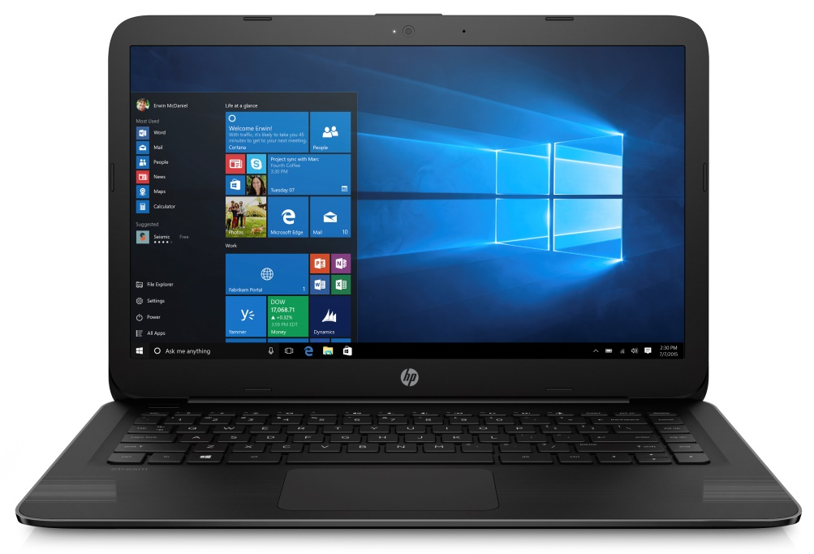
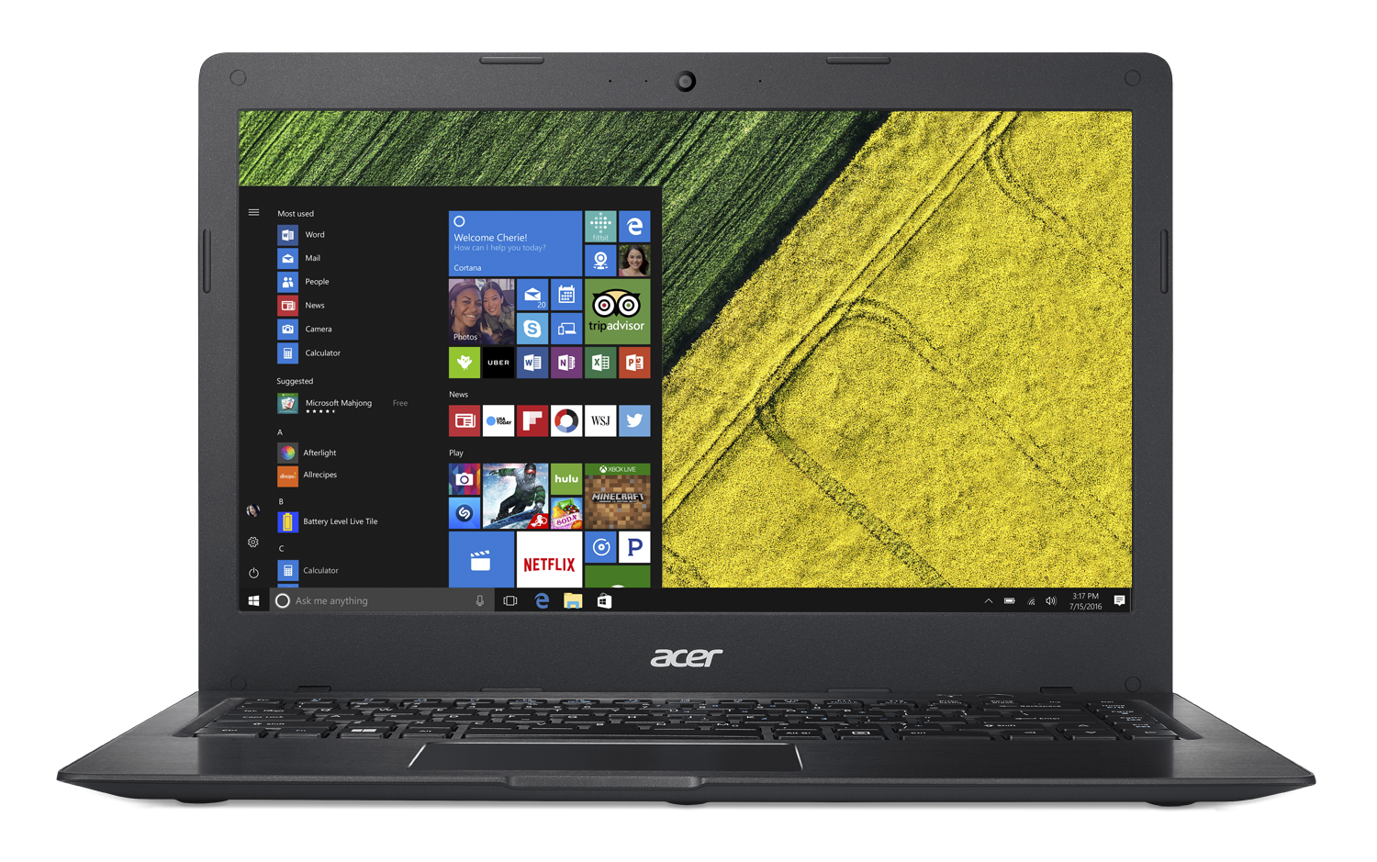
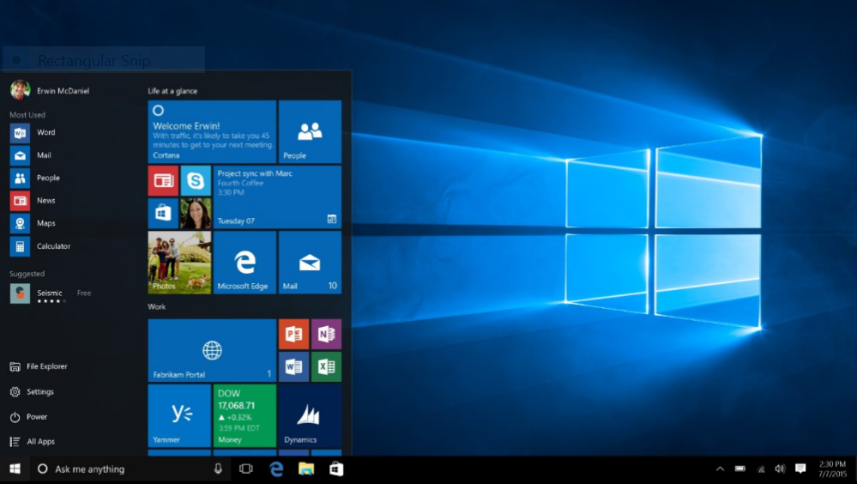
Windows 10 Pro device opportunity
Windows 10 Pro is the best investment for your customers
For about the same cost of a Chromebook you can get a Windows 10 Pro device that gives you modern management capabilities and access to all of your files (offline and online), all without sacrificing your identity and data security.
Device use case examples
Everyday computing device
A primary or secondary device that workers can use to take advantage of local apps, cloud services (such as OneDrive) and data storage in the office or on the road
Shared device (kiosk)
Multiple users access the same device for LoB apps, such as checking stock or inventory. These devices may be used by employees or customers.
VALUE OF WINDOWS 10 PRO DEVICE
Compatible & familiar OS and apps | Form factor choices | Secured simple management | Enterprise-grade security
Outstanding Windows 10 Pro devices
HP Stream 14 Pro G3
Acer Swift 1
Budget-friendly cloud notebook built for business—in the office and on the go. Sleek carbon design: 14” HD display, 4GB/64GB SSD and only 3.17lbs. Up to 10.5 hours of battery, powerful Intel® Celeron processor, and secure credentials via hardware and firmware TPM.
Slender and portable, perfect for all-day and shared use. 14” rich color anti-glare display. 4 GB DDR3L. 64 GB eMMC SSD. 3.5 lbs. 14-hour battery life. Fast multi-user MIMO wireless technology.

Slide 5
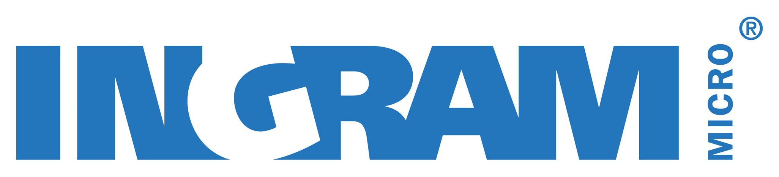

Windows 10 Pro device opportunity
How to get started
1
2
3
Start
Sell Windows 10 Pro devices
Grow
Sell services, including
Project-based, managed, and IP
Optimize
Cross-sell Office, Azure, CRM & EM + S + future Windows services
NEXT STEPS
Contact your Ingram Micro Channel Account Specialist Tommy Luong at tommy.luong@ingrammicro.com for more information

